Slide 1
Operating Systems Tutorial
Amit Dua
Computer Science and Information Systems Department
BITS, Pilani

Slide 2
Unix File System
Tutorial 6
Slides taken from the ones prepared by Dr. Mayuri Digalwar

Slide 3
OPEN system call
Syntax is
fd = open(pathname,flags,modes);
int open(const char *path, int flags, mode_t mode);
int open(const char *path, int flags);
where,
pathname is the file name
flags indicate type of file (reading/writing)
modes gives the file permission (if file is created)
Returns an integer called file descriptor
Rest of the system calls make use of this file descriptor.

Slide 4
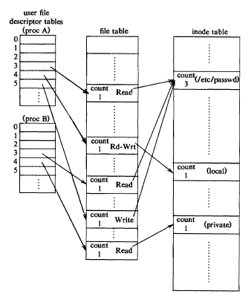

Slide 5
creat() system call
Syntax is
fd = creat(pathname,mode)
int creat(const char *path, mode_t mode);
modes-: permissions
flags : O_WRONLY|O_CREAT|O_TRUNC always same constant value, so no need to mention

Slide 6
Close ()
int close( int fd); /*file descriptor */
/* Returns 0 on success and -1 on error */
It makes the file descriptor available for re-use.
It does not flush any kernel buffers or perform any other clean-up task.

Slide 7
read() system call
size_t read(int fd, void *buf, size_t nbytes);
size_t write(int fd, void *buf, size_t nbytes);
fd – file descriptor
buf – buffer to hold data after read
nbytes – number of bytes to be read
Both functions return number of bytes read/written and returns -1 on error.

Slide 8
Write system call
#include<sys/types.h>
# include<unistd.h>
ssize_t write(
int fd, /* open file descriptor on which to write*/
const void *buf, /*data to write*/
ssize_t nbytes /*amount to write*/
);
/* Returns the number of bytes written or -1 on error */

Slide 9
lseek() system call
It sets the read/write pointer of a file descriptor which it can use for next read/write
off_t lseek(int fd, off_t offset, int reference);
offset is used to specify the position
reference is used by the offset
SEEK_SET – offset is absolute position
SEEK_CUR – offset is relative to the current position
SEEK_END – offset is relative to the end of the file

Slide 10
Close ()
#include <stdio.h>
#include <fcntl.h>
#include <unistd.h>
#include <sys/stat.h>
int main()
{
int fd1, ret;
fd1 = open(“txt1.txt”, O_RDONLY | O_CREAT, 0777);
ret = close(fd1);
printf(“\n Result:%d”, ret);
}

Slide 11
dup() system call
The dup() system call creates a copy of the file descriptor oldfd, using the lowest-numbered unused file descriptor for the new descriptor.
Syntax: int dup(int oldfd);
Return Value: On success, these system calls return the new file descriptor. On error, -1 is returned.

Slide 12
dup() system call
#include<stdio.h>
#include <unistd.h>
#include <fcntl.h>
int main()
{
int file_desc = open("dup.txt", O_WRONLY | O_APPEND);
if(file_desc < 0)
printf("Error opening the file\n");
int copy_desc = dup(file_desc);
write(copy_desc,"This will be output to the file named dup.txt\n", 46);
write(file_desc,"This will also be output to the file named dup.txt\n", 51);
return 0;
}

Slide 13
dup2() system call
The dup2() system call performs the same task as dup(), but instead of using the lowest-numbered unused file descriptor, it uses the file descriptor number specified in newfd. If the file descriptor newfd was previously open, it is silently closed before being reused.
Syntax: int dup2(int oldfd, int newfd);
Return Value: On success, these system calls return the new file descriptor. On error, -1 is returned.

Slide 14
dup2() system call
#include<stdlib.h>
#include<unistd.h>
#include<stdio.h>
#include<fcntl.h>
int main()
{
int file_desc = open("tricky.txt",O_WRONLY | O_APPEND);
dup2(file_desc, 1) ;
printf("I will be printed in the file tricky.txt\n");
return 0;
}

Slide 15
dup() and dup2() system call
#include<stdlib.h>
#include<unistd.h>
#include<fcntl.h>
int main()
{
int fd1, fd2;
fd1 = open(“txt1.txt”, O_RDONLY | O_CREAT, 777);
close(2);
dup(fd1);
}

Slide 16
dup() and dup2() system call
#include<stdlib.h>
#include<unistd.h>
#include<fcntl.h>
int main()
{
int fd1, fd2, fd3;
fd1 = open(“txt1.txt”, O_RDONLY | O_CREAT, 777); //3
fd2 = open(“txt2.txt”, O_RDONLY | O_CREAT, 777); //4
//close (fd2);
fd3=dup2(fd1, fd2);
}

Slide 17
chmod system call
The chmod command is used to change the access mode of a file.
Syntax: chmod [reference][operator][mode] filename
The references are used to distinguish the users to whom the permissions apply i.e. they are list of letters that specifies whom to give permissions.
Reference Class
u owner
g group
o others
a all

Slide 18
chmod system call
The operator is used to specify how the modes of a file should be adjusted. The following operators are accepted:
Operator Description
+ Adds the specified modes to the specified classes.
- Removes the specified modes from the specified classes.
= The modes specified are to be made the exact modes for the specified classes.

Slide 19
chmod system call
The modes indicate which permissions are to be granted or removed from the specified classes. There are three basic modes which correspond to the basic permissions:
Mode Description
r Permission to read the file.
w Permission to write (or delete) the file.
x Permission to execute the file, or, in the case of a directory, search it.

Slide 20
chmod system call
- rw- rw- r-- shashank shashank text1.c
- rw- rw- r-- shashank shashank text2.c
d rwx rwx r-x shashank shashank BITS
- rw- rw- r-- shashank shashank semaphore.c
rwx r-x r-x shashank shashank xyz.c
BEFORE: - rw- rw- r-- shashank shashank text1.c
COMMAND: chmod u=r text1.c
AFTER: - r-- rw- r-- shashank shashank text1.c

Slide 21
chmod system call
Let’s restrict the permission such that the user cannot search the directory BITS.
- r-- rw- r-- shashank shashank text1.c
- rw- rw- r-- shashank shashank text2.c
d rwx rwx r-x shashank shashank BITS
- rw- rw- r-- shashank shashank semaphore.c
rwx r-x r-x shashank shashank xyz.c
BEFORE: drwxrwxr-x shashank shashank BITS
COMMAND: chmod u=rw BITS
AFTER: drw-rwxr-x shashank shashank BITS

Slide 22
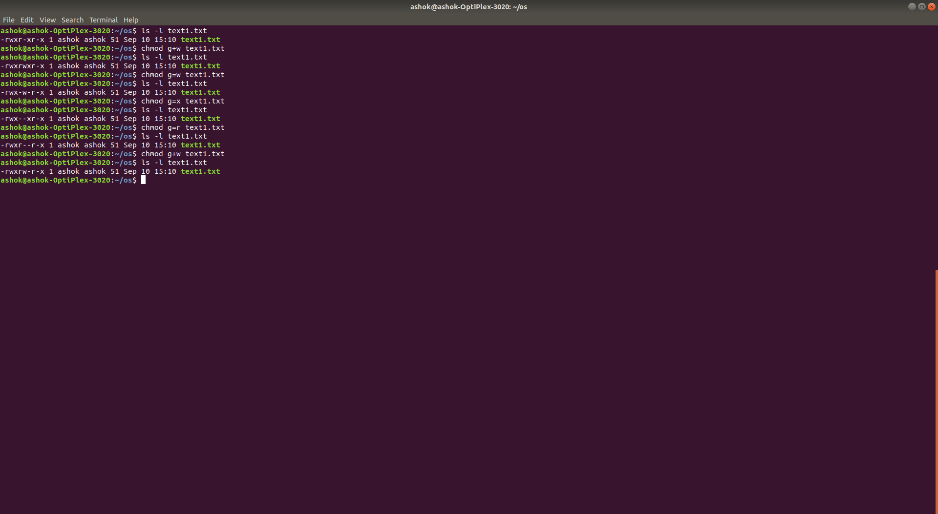
Example:

Slide 23
chown system call
The chown command changes the user and/or group ownership of for given file..
Syntax
chown owner-user file
chown owner-user:owner-group file
chown owner-user:owner-group directory

Slide 24
chown system call
First, list permissions for demo.txt, enter:
ls -l demo.txt
Sample outputs: -rw-r--r-- 1 root root 0 Aug 31 05:48 demo.txt
In this example change file ownership to vivek user and list the permissions, run:
chown vivek demo.txt
ls -l demo.txt
Sample outputs:
-rw-r--r-- 1 vivek root 0 Aug 31 05:48 demo.txt

Slide 25
chown system call
Now, the owner is set to vivek followed by a colon and a group ownership is also set to vivek group, run:
chown vivek:vivek demo.txt
ls -l demo.txt
Sample outputs:-rw-r--r-- 1 vivek vivek 0 Aug 31 05:48 demo.txt

Slide 26
chown system call
Here, we have changed only the group of file. To do so, the colon and following GROUP-name ftp are given, but the owner is omitted, only the group of the files is changed:
chown :ftp demo.txt
ls -l demo.txt
Sample outputs:
-rw-r--r-- 1 vivek ftp 0 Aug 31 05:48 demo.txt

Slide 27
Directory System Calls
getcwd()
mkdir()
chdir()
rmdir()
opendir()
closedir()
readdir()

Slide 28
getcwd System Call
To get the current working directory in UNIX, we use the “pwd” command.
The system call behind the “pwd” command is the getcwd() call.
# include<unistd.h>
char *getcwd(
char *buf, /* Returned pathname */
size_t bufsize /* sizeof buf */
);
/* Returns pointer to 'buf' on success and NULL on error */
bufsize is the maximum size of path. Following system call can be used to get maximum size of path.
long max= pathconf(“/”,_PC_PATH_MAX);

Slide 29
A program that uses the getcwd()
# include<stdio.h>
# include<unistd.h>
int main(void) {
long max;
char *buf;
max= pathconf(“/”,_PC_PATH_MAX);
buf=(char*)malloc(max);
getcwd(buf,max);
printf(“%s\n”,buf);
return 0;
}

Slide 30
chdir System Call(cd command in Unix)
# include<unistd.h>
int chdir(
const char *path;
);
/* Returns 0 on success and -1 on error */
This system call changes the current working directory to that specified in “path”.

Slide 31
Make and remove dir System Call
# include<sys/stat.h>
int mkdir(
const char *path, /* Pathname */
mode_t perms /* Permissions */
);
/* Returns 0 on success and -1 on error */
int rmdir(
const char *path /* Pathname */
);
/* Returns 0 on success and -1 on error */

Slide 32
Program to make and remove directory
int main(int argc,char *argv[])
{ int md,rd;
DIR *ds;
struct dirent *dir;
md = mkdir(argv[1],0777);
if(md == 0)
printf("%s directory is created\n",argv[1]);
else
printf("%s directory is not created\n",argv[1]);
rd = rmdir(argv[2]);
if(rd == 0)
printf("%s directory is removed\n",argv[2]);
else
printf("%s directory is not removed\n",argv[2]);
}

Slide 33
opendir and closedir System Calls
# include<dirent.h>
DIR* opendir(
const char *path /* directory pathname */
);
/* Returns a DIR pointer or NULL on error */
# include<dirent.h>
int closedir(
DIR *dirp /*DIR pointer from opendir */
);
/* Returns a 0 on success or -1 on error */

Slide 34
readdir System Call and dirent structure
#include <dirent.h>
struct dirent *readdir(
DIR *dirp /* DIR Pointer from opendir */
);
/* Returns structure or NULL on EOF or error */
struct dirent {
ino_t d_ino; /* i-number */
char d_name[]; /* name */
};

Slide 35
int main(int argc,char *argv[])
{
DIR *ds; struct dirent *dir;
ds = opendir(argv[1]);
if(ds == NULL)
printf("directory %s is not opened\n",argv[1]);
else
printf("ds = %ld\n",ds);
printf("list of files and directories\n");
while((dir = readdir(ds)) != NULL)
printf("%s\n",dir->d_name);
if((cld = closedir(ds)) == 0)
printf("%s is successfully closed\n",argv[1]);
else
printf("%s is not successfully closed\n",argv[1]);
}
[Mayuri@localhost dirProgs]$ ./a.out /home/Mayuri/Downloads/
open the directory
ds = 9236496
list of files and directories
..
.
SimplescalarHowto.pdf
Installation_Guide_for_SimpleScalar.pdf
p130-spradling.pdf
/home/Mayuri/Downloads/ is successfully closed
[Mayuri@localhost dirProgs]$

Slide 36
Questions ??

Slide 37
Lower level File System Algorithms
Name of Algorithm | Operation
namei | Parses the path name one component at a time and returns the inode of the input path name.
iget | Allocates the in-core copy of the inode if it exist and locks it. The inode is returned with reference count 1 greater than previous.
iput | Releases the inode by decrementing the reference count. Unlocks the inode to provide access to other system calls. Stores back if in-core copy is different from disk copy.
bmap | Converts a file byte offset into a physical disk block.
ialloc | Allocates the inode for a new file from the free list of inodes
ifree | If reference count becomes 0, the inode is released and added to the free list of inodes
alloc | Allocates the disk inode
free | Releases the disk inode

Slide 38
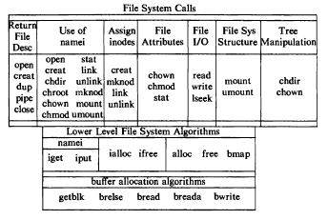
File System Calls and Relation to Algorithms

Slide 39
program to display the detailed directory structure (output)
mayuri@atlas:~$ ./a.out dsa
Directory scan of dsa
lab1/
SortedSeqList.h
greedyAlgos/
a.out
coinset.c
IntervalScheduling/
a.out
dataDef.h
output.txt
schOps.h
input.txt
main.c
schedulingOps.c
schedulingOps.o
**************DONE************
mayuri@atlas:~$

Slide 40
Programming Exercise
Write a program to make a directory, create two text files inside it, open the directory and file. Write to one of the files and then copy content of one file to another. Close the files and the directory.

Slide 41
Thank You

